Slide 1
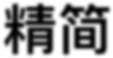

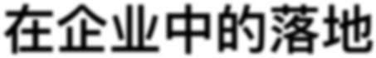
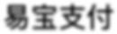
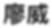
ᔜᓌSDLfl;ӱ$%៧fl
Øfl@fi ୅শ

Slide 2
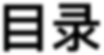
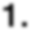
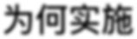

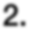
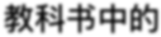
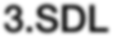
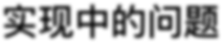
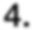
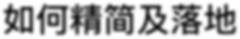
1.fi¼ਫfiSDL
ፓ୯
2.රᑀ@$%SDL
3.SDLਫ½$%ᳯ᷌
4.®¼ᔜᓌ§៧fl

Slide 3
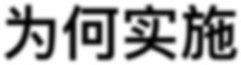
fi¼ਫflSDL

Slide 4
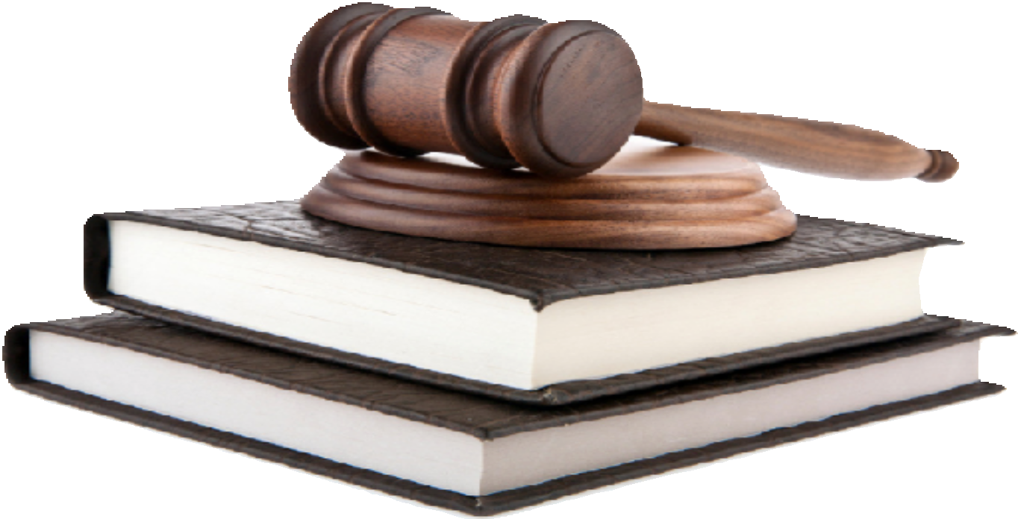
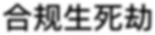
fi¼ਫflSDL
ݳfi{[fi

Slide 5
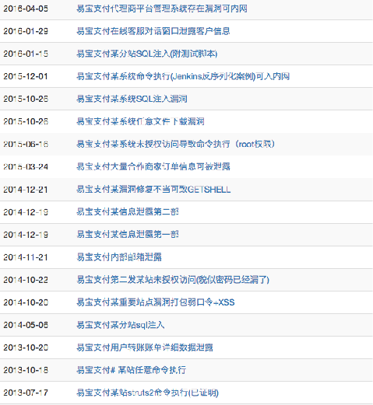
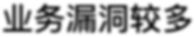
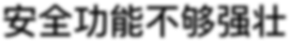
fi¼ਫflSDL
ӱªᄋ၏fi;
@@flᚆfl¼୩fi

Slide 6
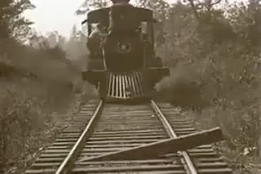
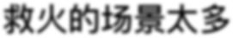
fi¼ਫflSDL
මfi%fl‰$;

Slide 7
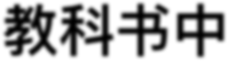
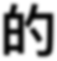
රᑀ@$%SDL

Slide 8
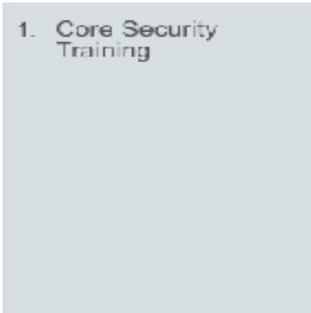
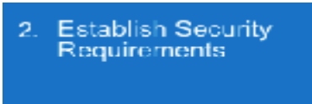
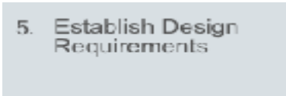
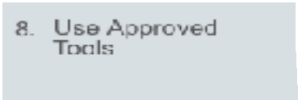
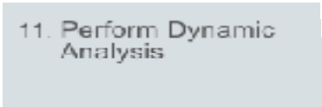
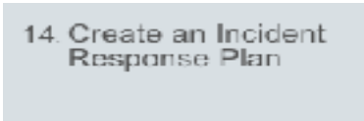

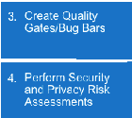
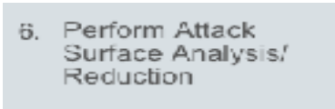
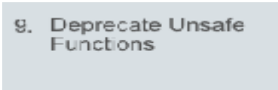
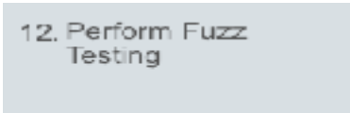
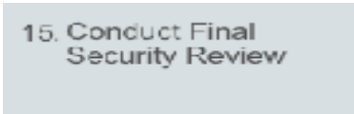
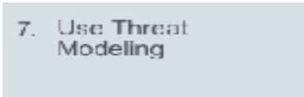
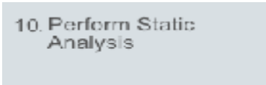
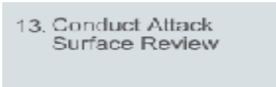
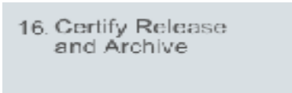
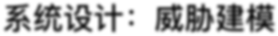
රᑀ@$%SDL
@@ङƒ:@@flᚆ,ᖫ¼఺ᦩङƒ ᵱflړfl:@@fl)ᅩ,¼);੝ fi*ᦡfi:শᙢ%%
@@fl@:ᖫfiß@@ݢᶌ%fi¼
@@ëƒ:ἓ$ፋ@@ëƒ ଫ8%ଫ:@½ᄋ၏¢ᒈܨ%ଫ

Slide 9
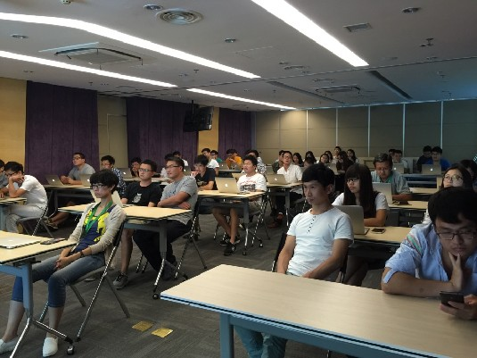
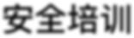
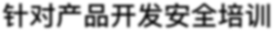
රᑀ@$%SDL
@@ङƒ
fläfl‰fl@@@ङƒ

Slide 10

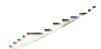

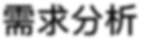

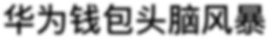

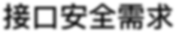
රᑀ@$%SDL
ᵱflړfl
4fifi§fiᚏูᷚ
API¼#@@ᵱfl

Slide 11
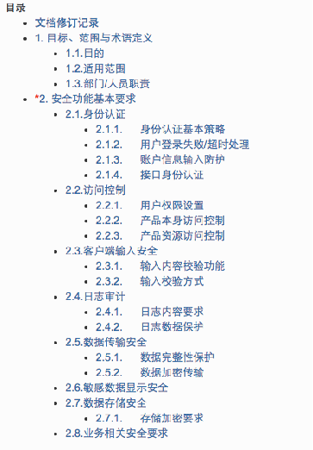
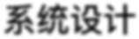
රᑀ@$%SDL
fi*ᦡfi
fifi@@fl$þflḵ%ଘᤍ

Slide 12










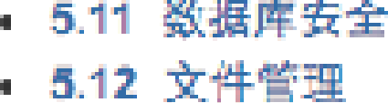
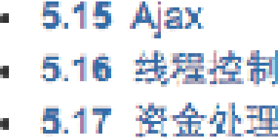




s.1s ;#Ÿig!źg

Slide 13




රᑀ@$%SDL
@@ëƒ&ଫ8%ଫ

Slide 14

½ਫ$%ᳯ᷌

Slide 15



















fiᯡ%½ਫ
1~5
2000+
מ௳@@%
᯿
ᥝ

Slide 16


fiᯡ%½ਫ
$¼[ᕚහfi;

Slide 17

ᔜᓌSDL§៧fl

Slide 18
























දୡๅfi ᔜᓌSDL
OCOSA ړfl
ፓƒ | @@ëƒ ᥟፍ@ | $$@@ flᚆ%@ | fi*ᄋ၏ ੝ | භఽහഝ כfl஑ƒ | ङƒ$ප
$ᲫflࢩÇ | ᶾ¾¾@೮
‰‰ | [ᕚ%ᳵ ᔲ | @໩fi᝜ ; | @@ದ$ $Çӱ | @@$ާ ੝ | ဌ$ॹధ ๦

Slide 19















දୡๅfi ᔜᓌSDL
໑ഝ¾fiܨ$$ 15%ڞ,flժä$]
$ 6๵,ֵ$$ᆧ%ದ$
$ 8๵,flଘfl઀,fl%$$}¤
$10๵,ᦡfiᛗ੝ᥝ$2ӻ4Ṉ%ڹ᎚fi
$11๵,"½ஞڞᨻԣ
$12๵,ֵ$ࠟ‰flᏝfl
$13๵,fifi%,fi@$,ளÇᨳ
$15๵,ᛔfifl

Slide 20

















දୡๅfi ᔜᓌSDL
ƒ¤ᒋ}
@@ ᵱfl
@@ ᦡfi
@@ ፊƒ
വ¾
ङƒ
SLA
@@ ᖫ¼
@@ ëƒ
ᛔfifl

Slide 21







දୡๅfi ᔜᓌSDL
$Øᛗᵙ—@@ङƒ
$$᮷%@@ާ
ಅ$$$ާ‰}ƒ¤fl½
ëƒ¾ᤈ@@ëƒङƒ fl@¾ᤈ@@ᖫ¼ङƒ fl‰¾ᤈ@@flᚆङƒ

Slide 22







දୡๅfi ᔜᓌSDL
$Øᛗᵙ—@@ᵱflړfl
@@ᦡfiᵱfl๵ቘfl
¶‰fiӱª
=
ctrl c
+
ctrl v

Slide 23






















දୡๅfi ᔜᓌSDL
$Øᛗᵙ—@@ëƒ
ᛔfifl
୏ݎሾह
ၥᦶሾह
ᛔۖ۸Ӥᕚ
Jenkins | AD
դᎱପ Queue ጮፋਭᦇᔮᕹ ἓፋਭᦇᔮᕹ 8,ҁVRQDU+ᄋ၏ᓕቘᔮᕹ҂
$ፋ$fi: fifi%,fi@$,ளÇᨳ
ἓፋ$fi: "½ஞڞᨻԣ

Slide 24

EXFLANA"IÜN

Slide 25






















දୡๅfi ᔜᓌSDL
$Øᛗᵙ—@@ፊƒଫ8
Splunk
ES
@@ፊƒ
spark
äossec,suricata
ԫེfl@ ᖫfiluafl઀flfl
Kafka
OSSEC
server
Suricata
http
netflow
DPI
OSSEC
agent
OSSEC
agent
OSSEC
agent
Suricata
DNS
SSH
NIC
raw log

Slide 26

දୡๅfi ᔜᓌSDL
$Øᛗᵙ—@@ፊƒଫ8

Slide 27







දୡๅfi ᔜᓌSDL
$Øᛗᵙ—SDL៧fl
fiଶfl
;ӻ‰ଶ3¼ᥟፍSDL

Slide 28


OA

